Slide 1
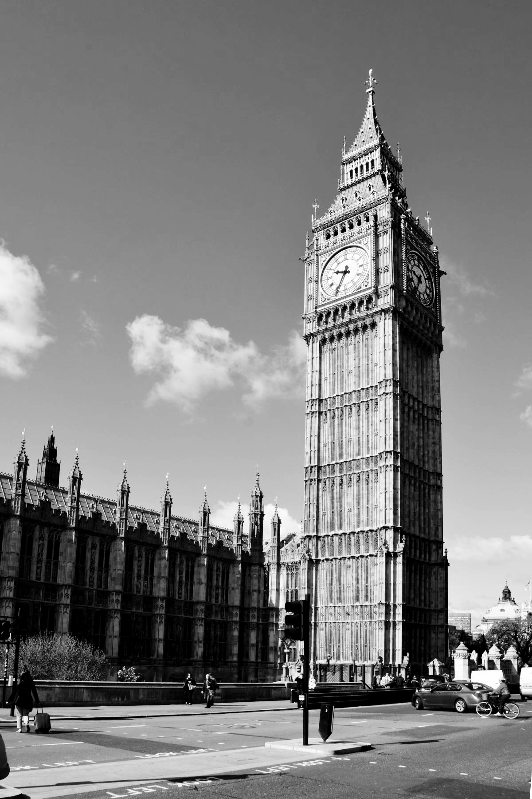
Travel Pack
Prepared for:
John Uvietaire
United KIngdom
Dec 20-Dec 23 2025

Slide 2
Table of Contents
1 | Entry/Exit Requirements
2 | Etiquette and Cultural Expectations
3 | Event Information
4 | Budget
5 | Travel Itinerary

Slide 3
Entry/Exit information

Slide 4
Documentation Requirements
ENTRY:
Passport with expiration date more than 6 months from entry date (✔)
UK Visa
Financial and intention to return
Purpose of your visit
Health / COVID-19 rules
EXIT:
There are generally no border exit checks (passport stamping) for many travellers — but airlines and transit countries will check validity of your documents.

Slide 5
Etiquette and Cultural Expectations

Slide 6
Cultural Expectations
Be punctual
Queue patiently
Don’t interrupt
“Sorry” is often used to be polite, not always as an apology.

Slide 7
Event
Information
Explore London’s Landmarks (Day 1)
Experience British Culture & Food (Day 2)
Take a Short Day Trip (Day 3)

Slide 8
Explore London’s Landmarks
Visit Buckingham Palace, Big Ben and Westminster Abbey
Walk along the River Thames and ride the London Eye for city views.
Stop by Trafalgar Square and Piccadilly Circus.

Slide 9
Experience British Culture & Food
Explore British Museum, National Gallery, or Tate Modern (free entry).
Try local dishes – fish & chips, Sunday roast, or afternoon tea.
Relax in Hyde Park or St. James’s Park.
Join a walking tour for a fun cultural experience.

Slide 10
Take a Short Day Trip
Visit Windsor – home of Windsor Castle.
Leave for this trip very early so you can be back in time for your flight

Slide 11
BUDGET
Budget | Cost (USD)
Visa application process | 130
Flights | 930
Accommodation | 220
Activities | 300
Meals | 100
Total cost | 1680

Slide 12
Itinerary
Date | Time | Activity / Details | Notes / Additional Info
Dec 20 (Fri) | 10:00 PM | Flight: Lagos → London (Heathrow/Gatwick) | Flight duration ~6–7 hrs; keep passport, visa, and travel documents handy.
Dec 21 (Sat) | 6:30 AM | Arrive in London, clear immigration, transfer to hotel | Hotel: Premier Inn London County Hall
Dec 21 (Sat) | 9:00 AM | Explore Westminster: Buckingham Palace, Big Ben, Westminster Abbey | Walking tour; photo opportunities.
Dec 21 (Sat) | 12:30 PM | Lunch at Southbank | Try local British dishes like fish & chips.
Dec 21 (Sat) | 2:00 PM | Ride the London Eye (Event Highlight) | Book tickets online; enjoy panoramic views of London for about 30–40 minutes.
Dec 21 (Sat) | 5:30 PM | Dinner at a nearby restaurant | Options: The Ivy or Southbank Centre Café.
Dec 22 (Sun) | 9:00 AM | Visit British Museum | Entry is free; spend 2–3 hours exploring exhibits.
Dec 22 (Sun) | 12:30 PM | Lunch & walk in Hyde Park | Relax and enjoy the scenery; optional boat ride or photography.
Dec 22 (Sun) | 3:00 PM | Afternoon Tea at Fortnum & Mason | Traditional British tea experience; book in advance.

